Slide 1



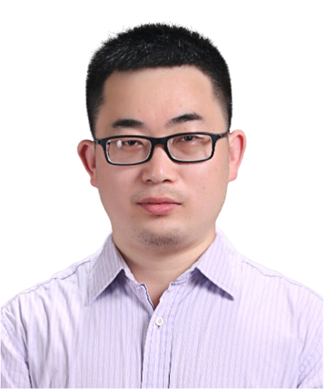
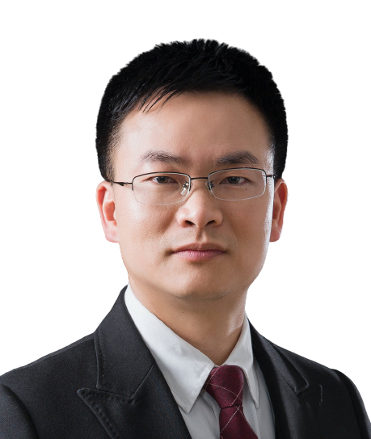
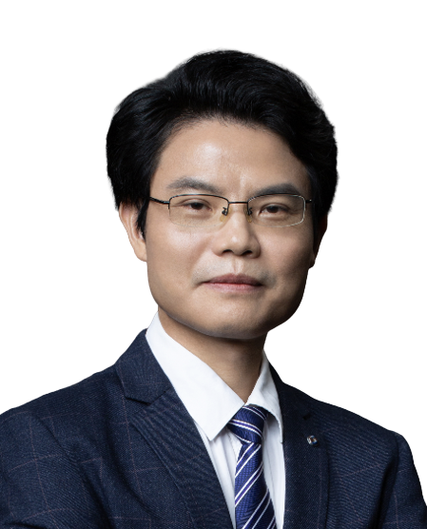
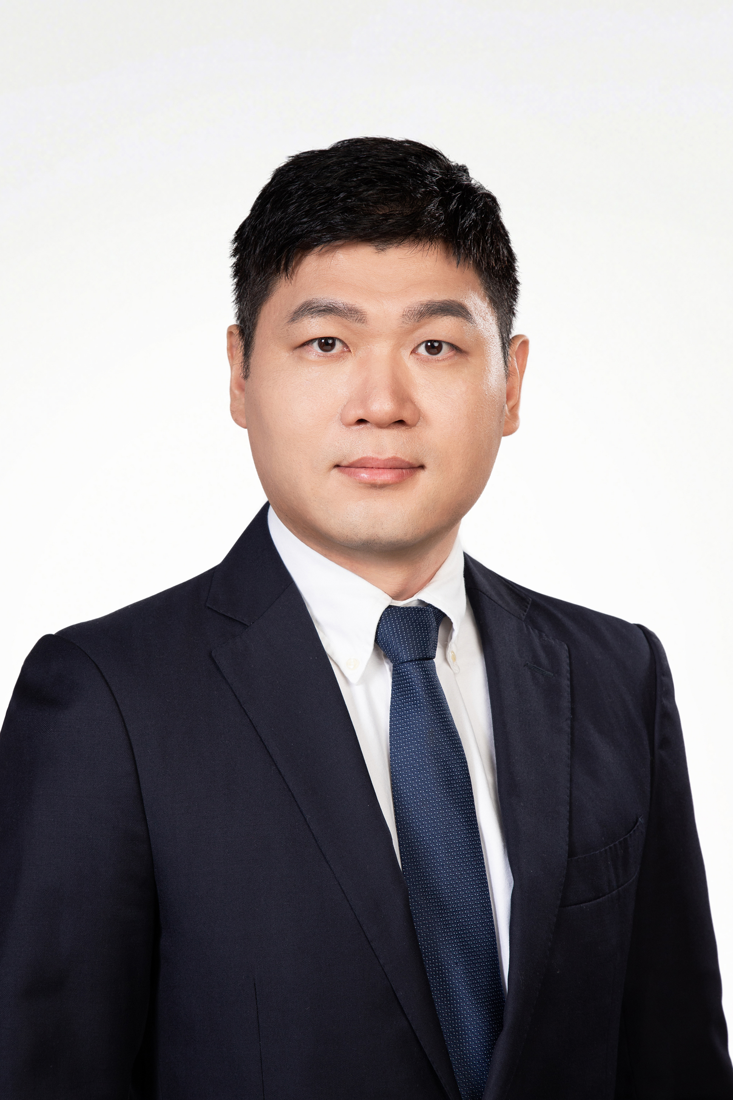
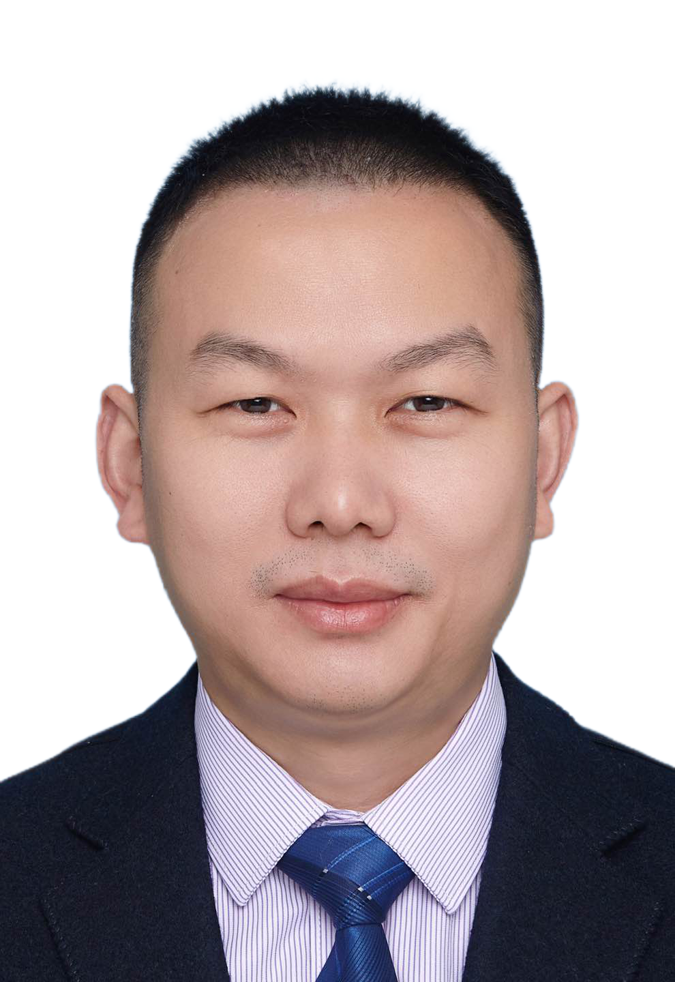

Detection, regulation, and functions of RNA methylation in animals and plants
Time (China): 2024/10/18 10:00-11:30
Tencent ID: 282-213-458
Tencent meeting link:
https://meeting.tencent.com/dm/81A1lV82EKcJ
Bilibili：https://live.bilibili.com/26427894
Prof. Guifang Jia
Peking University
Abstract:
Prof. Guifang Jia is a doctoral supervisor at the College of Chemistry and Molecular Engineering, Peking University. She is also a Principal Investigator (PI) at the Peking-Tsinghua Center for Life Sciences (CLS) and the Beijing RNA Research Center. Jia obtained her Bachelor's degree in Chemistry (2012) and her Ph.D. in Pesticide Science (2009) from China Agricultural University. From 2007 to 2012, she was a joint training graduate student and postdoctoral researcher in the Department of Chemistry at the University of Chicago.
Pof. Jia's research group has long focused on "Plant RNA Epigenetics," pioneering the exploration of RNA chemical modifications for crop breeding applications and advancing research in the field of plant RNA chemical modifications. Her research findings have been published in prominent international journals such as Nature Biotechnology, Nature Chemical Biology, Nature Communications, PNAS, Plant Cell, and Molecular Plant. She serves as an advisory editor for RSC Chemical Biology and ChemBioChem. She has received several prestigious awards, including the 19th China Young Women Scientists Award (2023), the National Science Fund for Distinguished Young Scholars (2022), and the National Science Fund for Excellent Young Scholars (2018).
HOST＆PANELISTS
HOST：Jinkai Wang
Sun Yat-sen University
Lin Huang
Sun Yat-sen University
Jianhua Yang
Sun Yat-sen University
Zhichao Miao
Guangzhou Laboratory
Guangzhou Medical University
Hongsheng Wang
Sun Yat-sen University
Sponsors

Slide 2
RNA甲基化修饰的检测、功能与调控
时间: 2024/10/18 10:00-11:30
腾讯会议 ID: 282-213-458
腾讯会议链接:
https://meeting.tencent.com/dm/81A1lV82EKcJ
哔哩哔哩：https://live.bilibili.com/26427894
贾桂芳
北京大学化学与分子工程学院
摘要：
贾桂芳，北京大学化学与分子工程学院研究员、博士生导师，北大清华生命联合中心（CLS）和北京核糖核酸研究中心PI。中国农业大学获得化学学士（2012）和农药学博士学位（2009），2007-2012年在芝加哥大学化学系先后做联合培养研究生和博士后。贾桂芳课题组长期聚焦“植物RNA表观遗传学”，率先探索RNA化学修饰对作物育种的应用，推动植物RNA化学修饰领域研究。研究成果发表在Nature Biotechnology、Nature Chemical Biology、Nature Communications、PNAS、Plant Cell、Molecular Plant等国际重要杂志期刊。在《RSC Chemical Biology》和《ChemBioChem》担任顾问编委。荣获第十九届中国青年女科学家奖（2023）、国家杰出青年科学基金（2022）和国家优秀青年科学基金（2018）。
主持人＆嘉宾
主持人：王金凯
中山大学
黄林
中山大学
杨建华
中山大学
苗智超
广州实验室
广州医科大学
王红胜
中山大学
赞助商

